Slide 1
Weekly meeting
3-7-2025
Ty Bottorff

Slide 2
Outline
NCI irAE analyses prompted by recent SI
Next steps for NCI/CD127

Slide 3
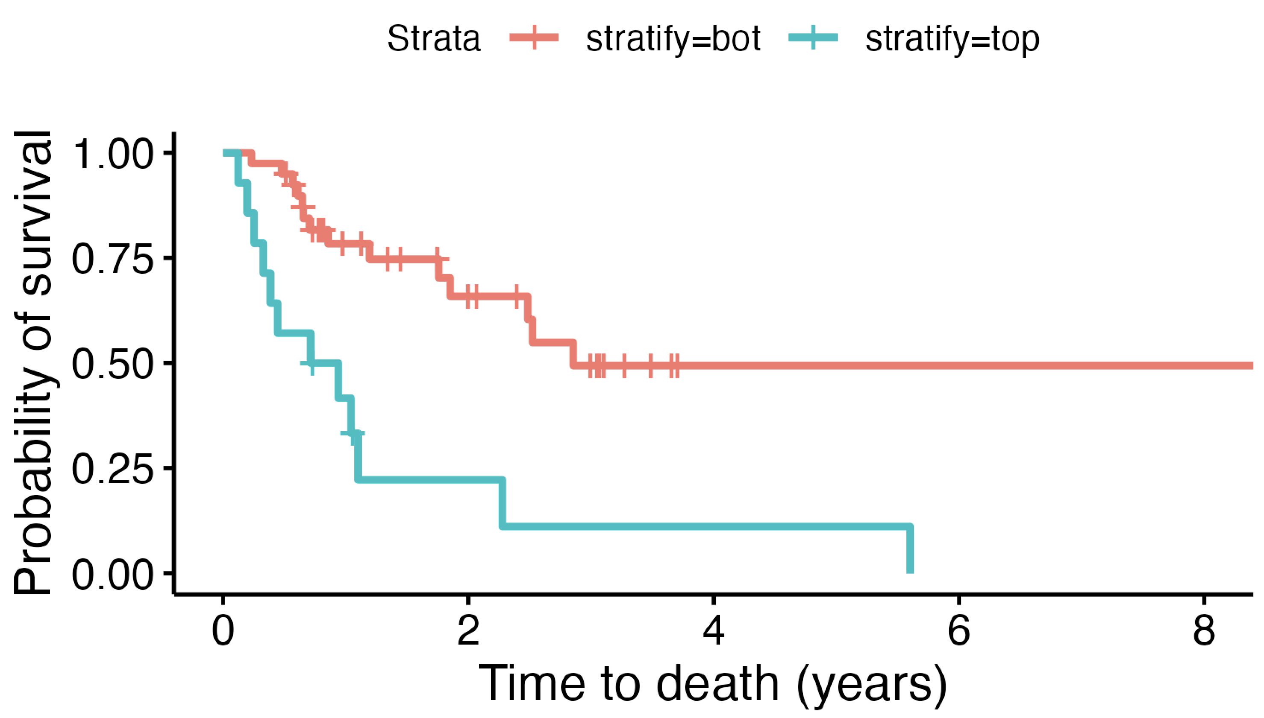
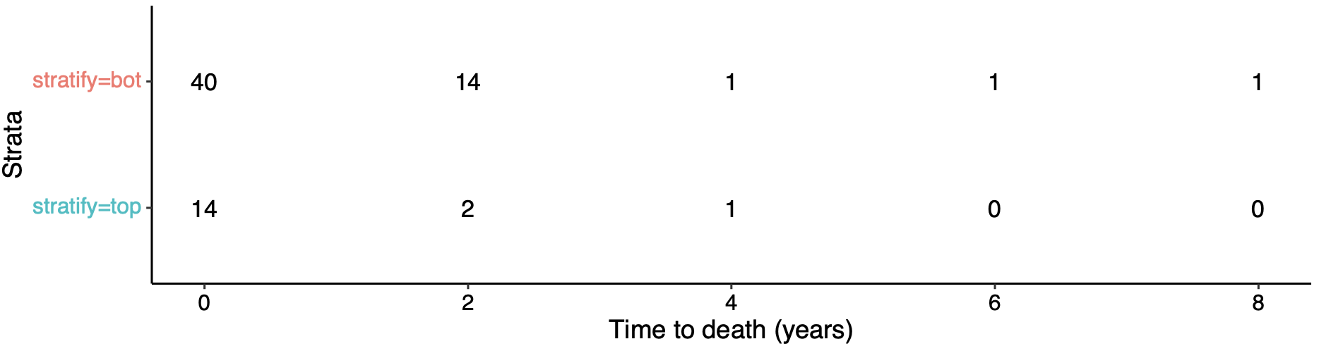
ICI patients with highest baseline frequencies of ICOS⁺ of T_{fh} T_{conv} die sooner
Bot 75%
Top 25%
padj = 0.01
Notes:
Using data lock date as end of study date
Filtered out patients who we lost contact with (don’t know if alive/dead at end date)
This doesn’t take batch effects into consideration…

Slide 4
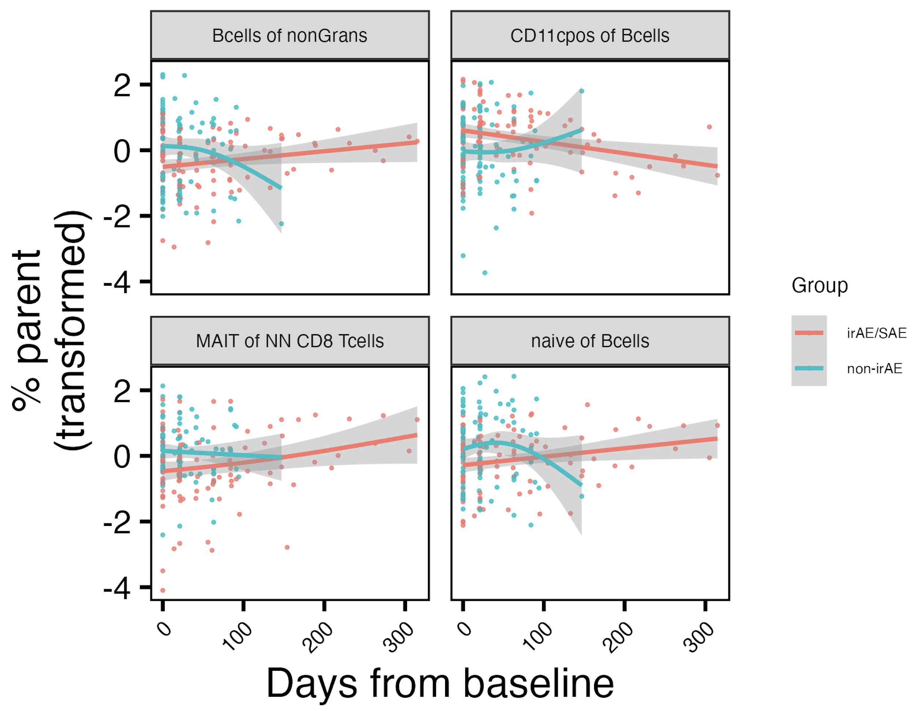
Populations changing differentially over ICI by combined irAE group
padj < 0.05 at baseline
*
*
padj < 0.1 at baseline
*
*
padj < 0.1 at baseline
padj < 0.1 at baseline
padj < 0.05: *
Notes:
Results ~changed with response in model formula too now

Slide 5
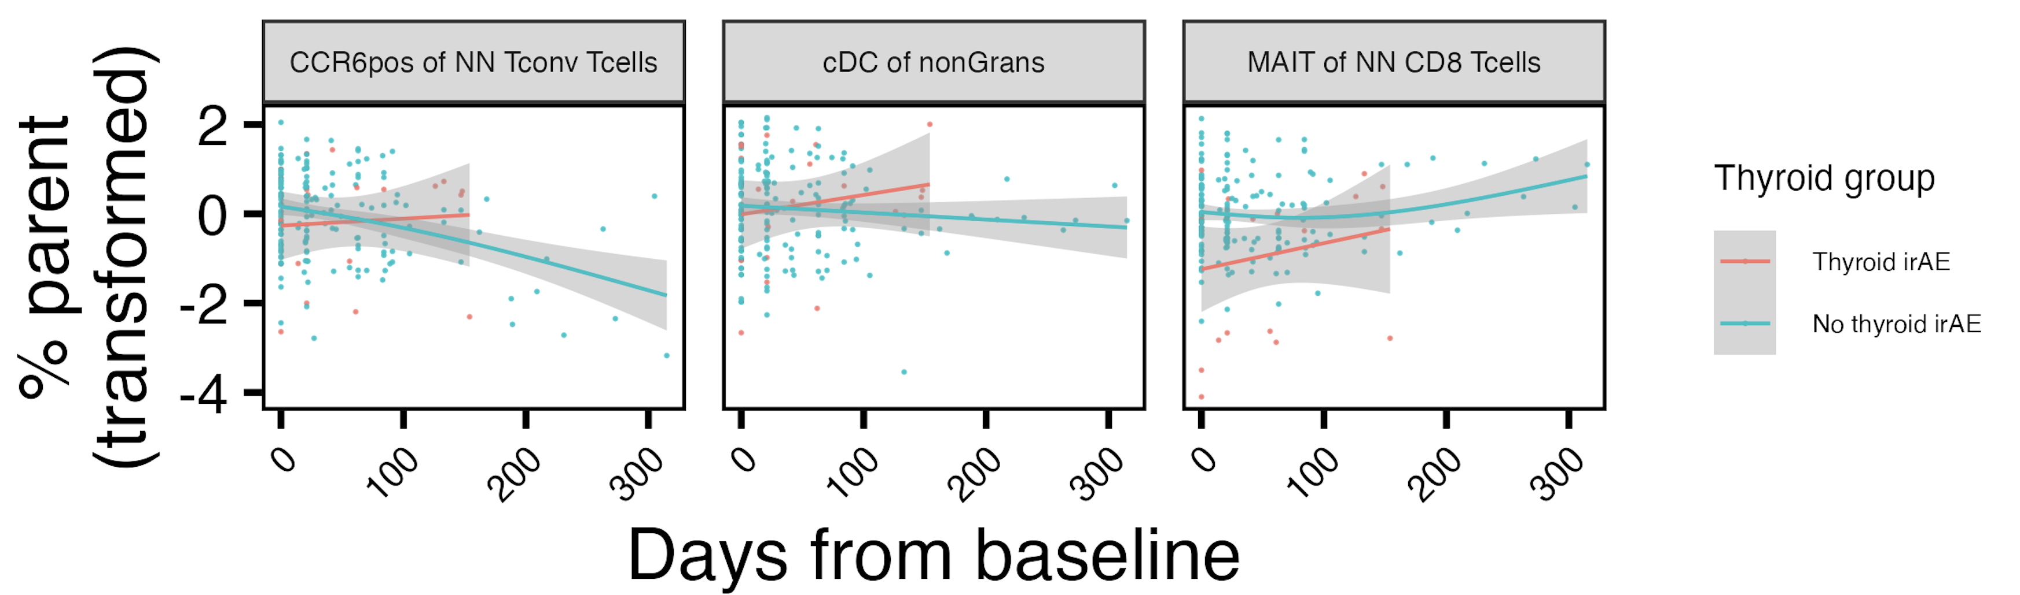
Populations changing differentially over ICI by thyroid irAE group
*
*
*
*
padj < 0.1 at baseline
padj < 0.05 at baseline
padj < 0.05: *
Notes:
Results ~changed with response in model formula too now

Slide 6
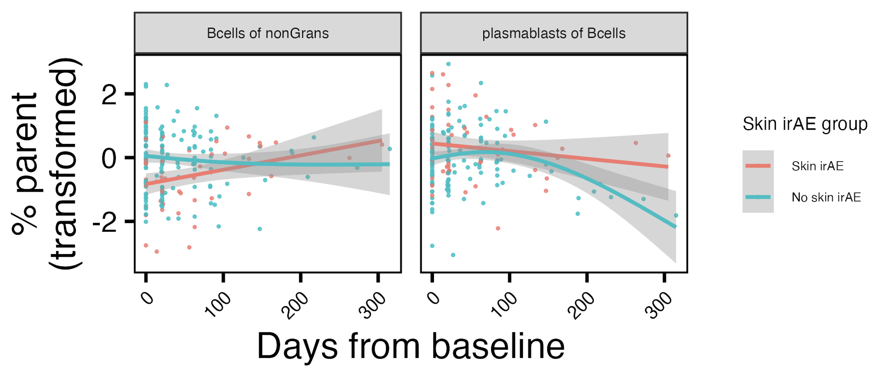
Populations changing differentially over ICI by skin irAE group
*
*
padj < 0.05 at baseline
padj < 0.05: *
Notes:
Results ~changed with response in model formula too now
Bcells of nonGrans lower at baseline in combined/skin irAE

Slide 7
Conclusions
ICI patients with highest baseline frequencies of ICOS⁺ of T_{fh} T_{conv} die sooner
T/B cell populations change differentially over ICI by +/- combined, skin, thyroid irAE

Slide 8
Next steps (NCI)
Experimental follow up ~same (sc not bulk)
Still focused on what’s driving any/specific irAEs (phenotype of T/B cells in those with thyroid, skin, other irAEs)
Cohort
4-6 groups
NCI: only thyroid irAE, only skin irAE, mixed irAE (non-skin/thyroid), no irAE
New AID samples (if age-matching possible): skin AID & thyroid AID
n = 3/group
1 time point for NCI groups: visit 3
Assay: scRNAseq of T/B cells sorted from PBMCs
Sample availability
500,000 PBMCs frozen in RLT (for RNA)/sample
Have info for volumes of samples leftover as well
Notes:
Sample meaning subject-timepoint
Complication: thyroid only group (n = 4) ¾ have irAE ~kinda long after most recent draw… (0, 40, 50, 60 days past irAE for next draw, and these are different times on ICI…)

Slide 9
Next steps (CD127)
Prepare for Wednesday discussion on CyTOF panel
Revisit KH KM plots for genes with patterns like CD127 (high expr → lower time to T1D)
Revisit WB RNAseq (any DEGs?)

Slide 10
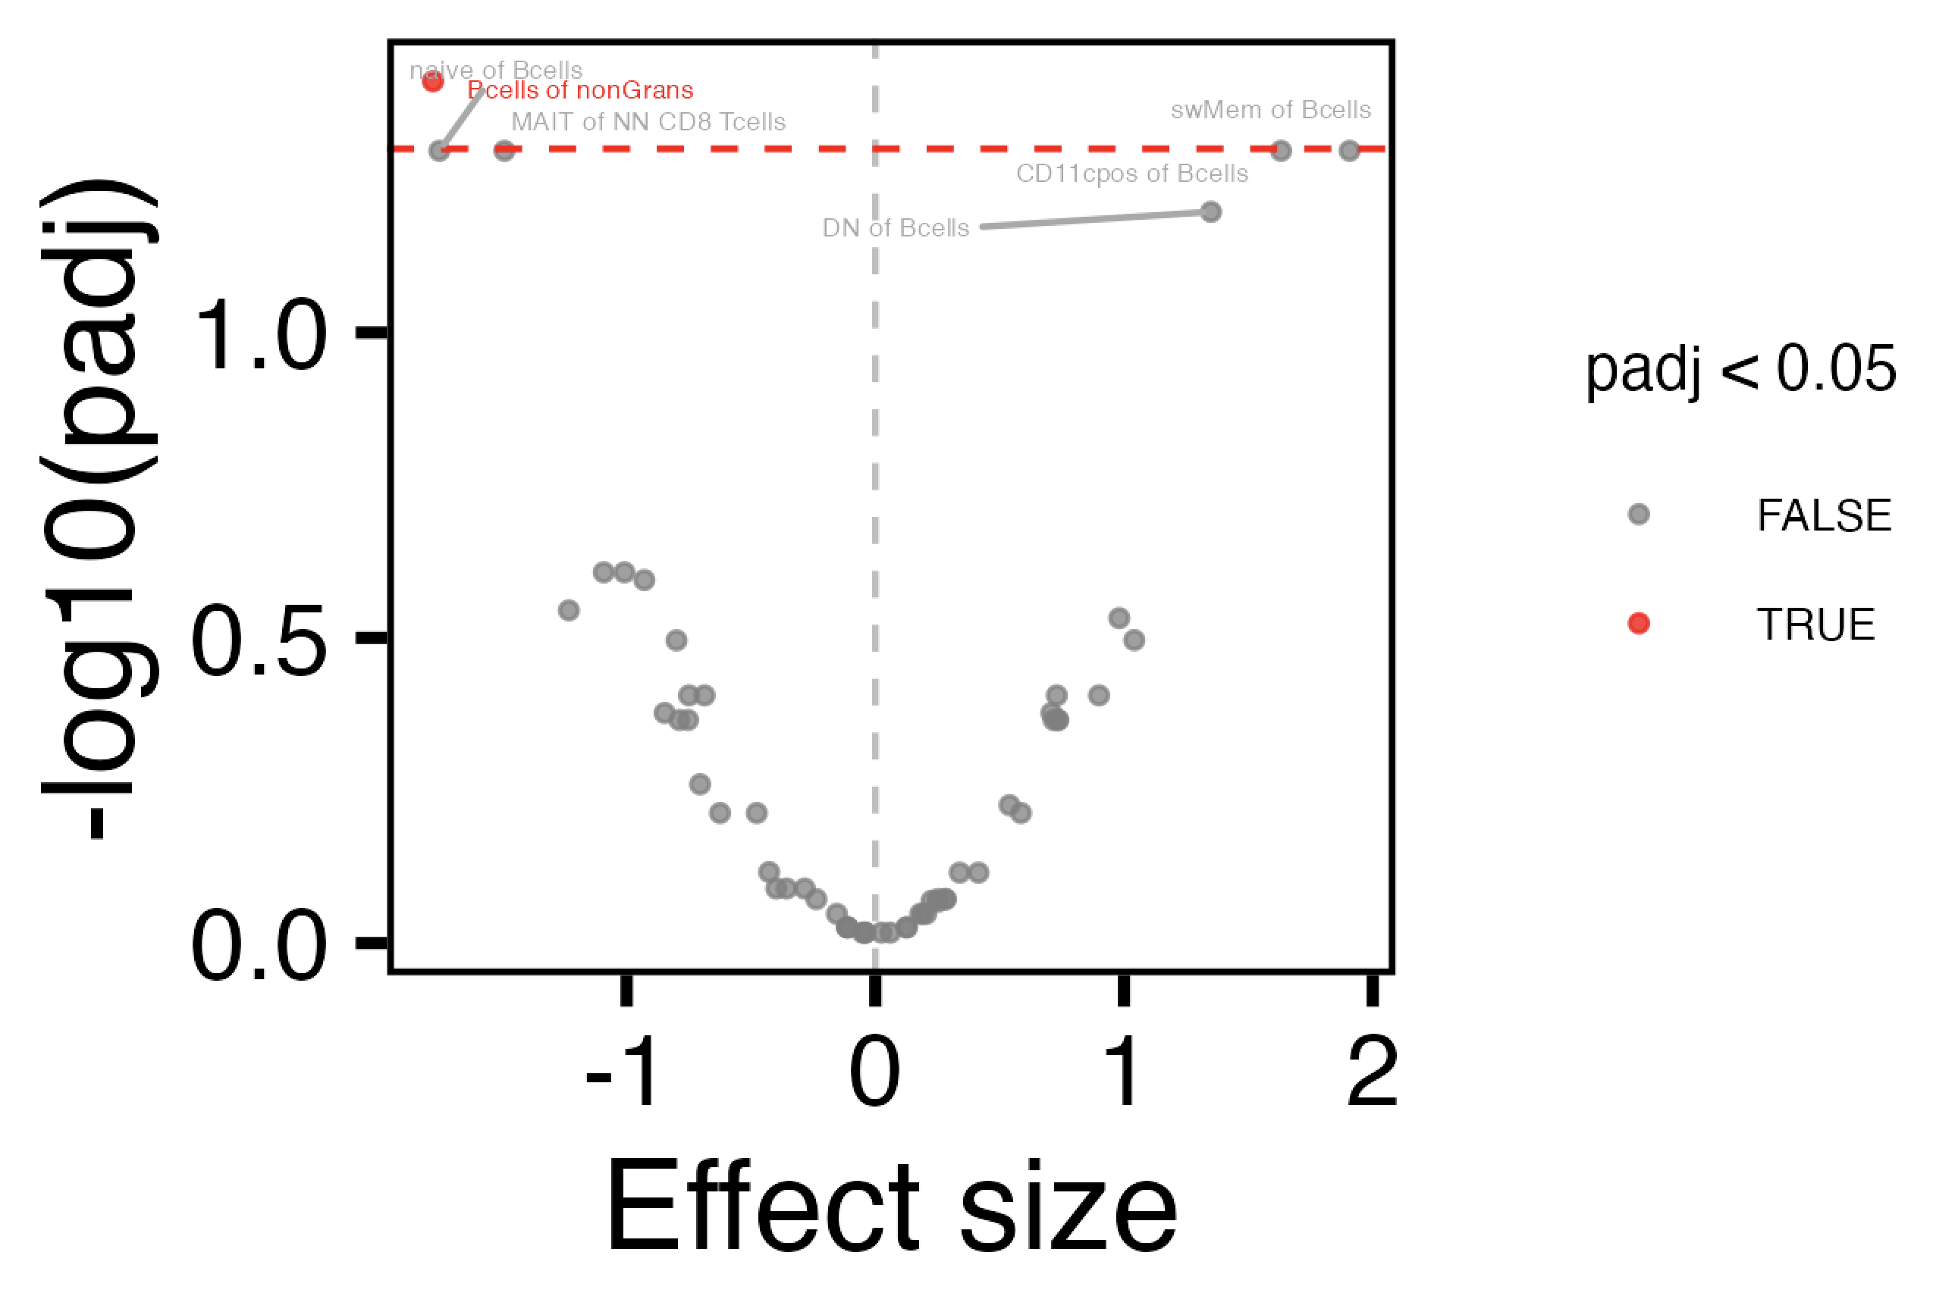
Revisiting borderline baseline combined irAE group differences
Notes:
Also see Bcells of nonGrans baseline difference for +/- skin irAE (padj < 0.05)

Slide 11
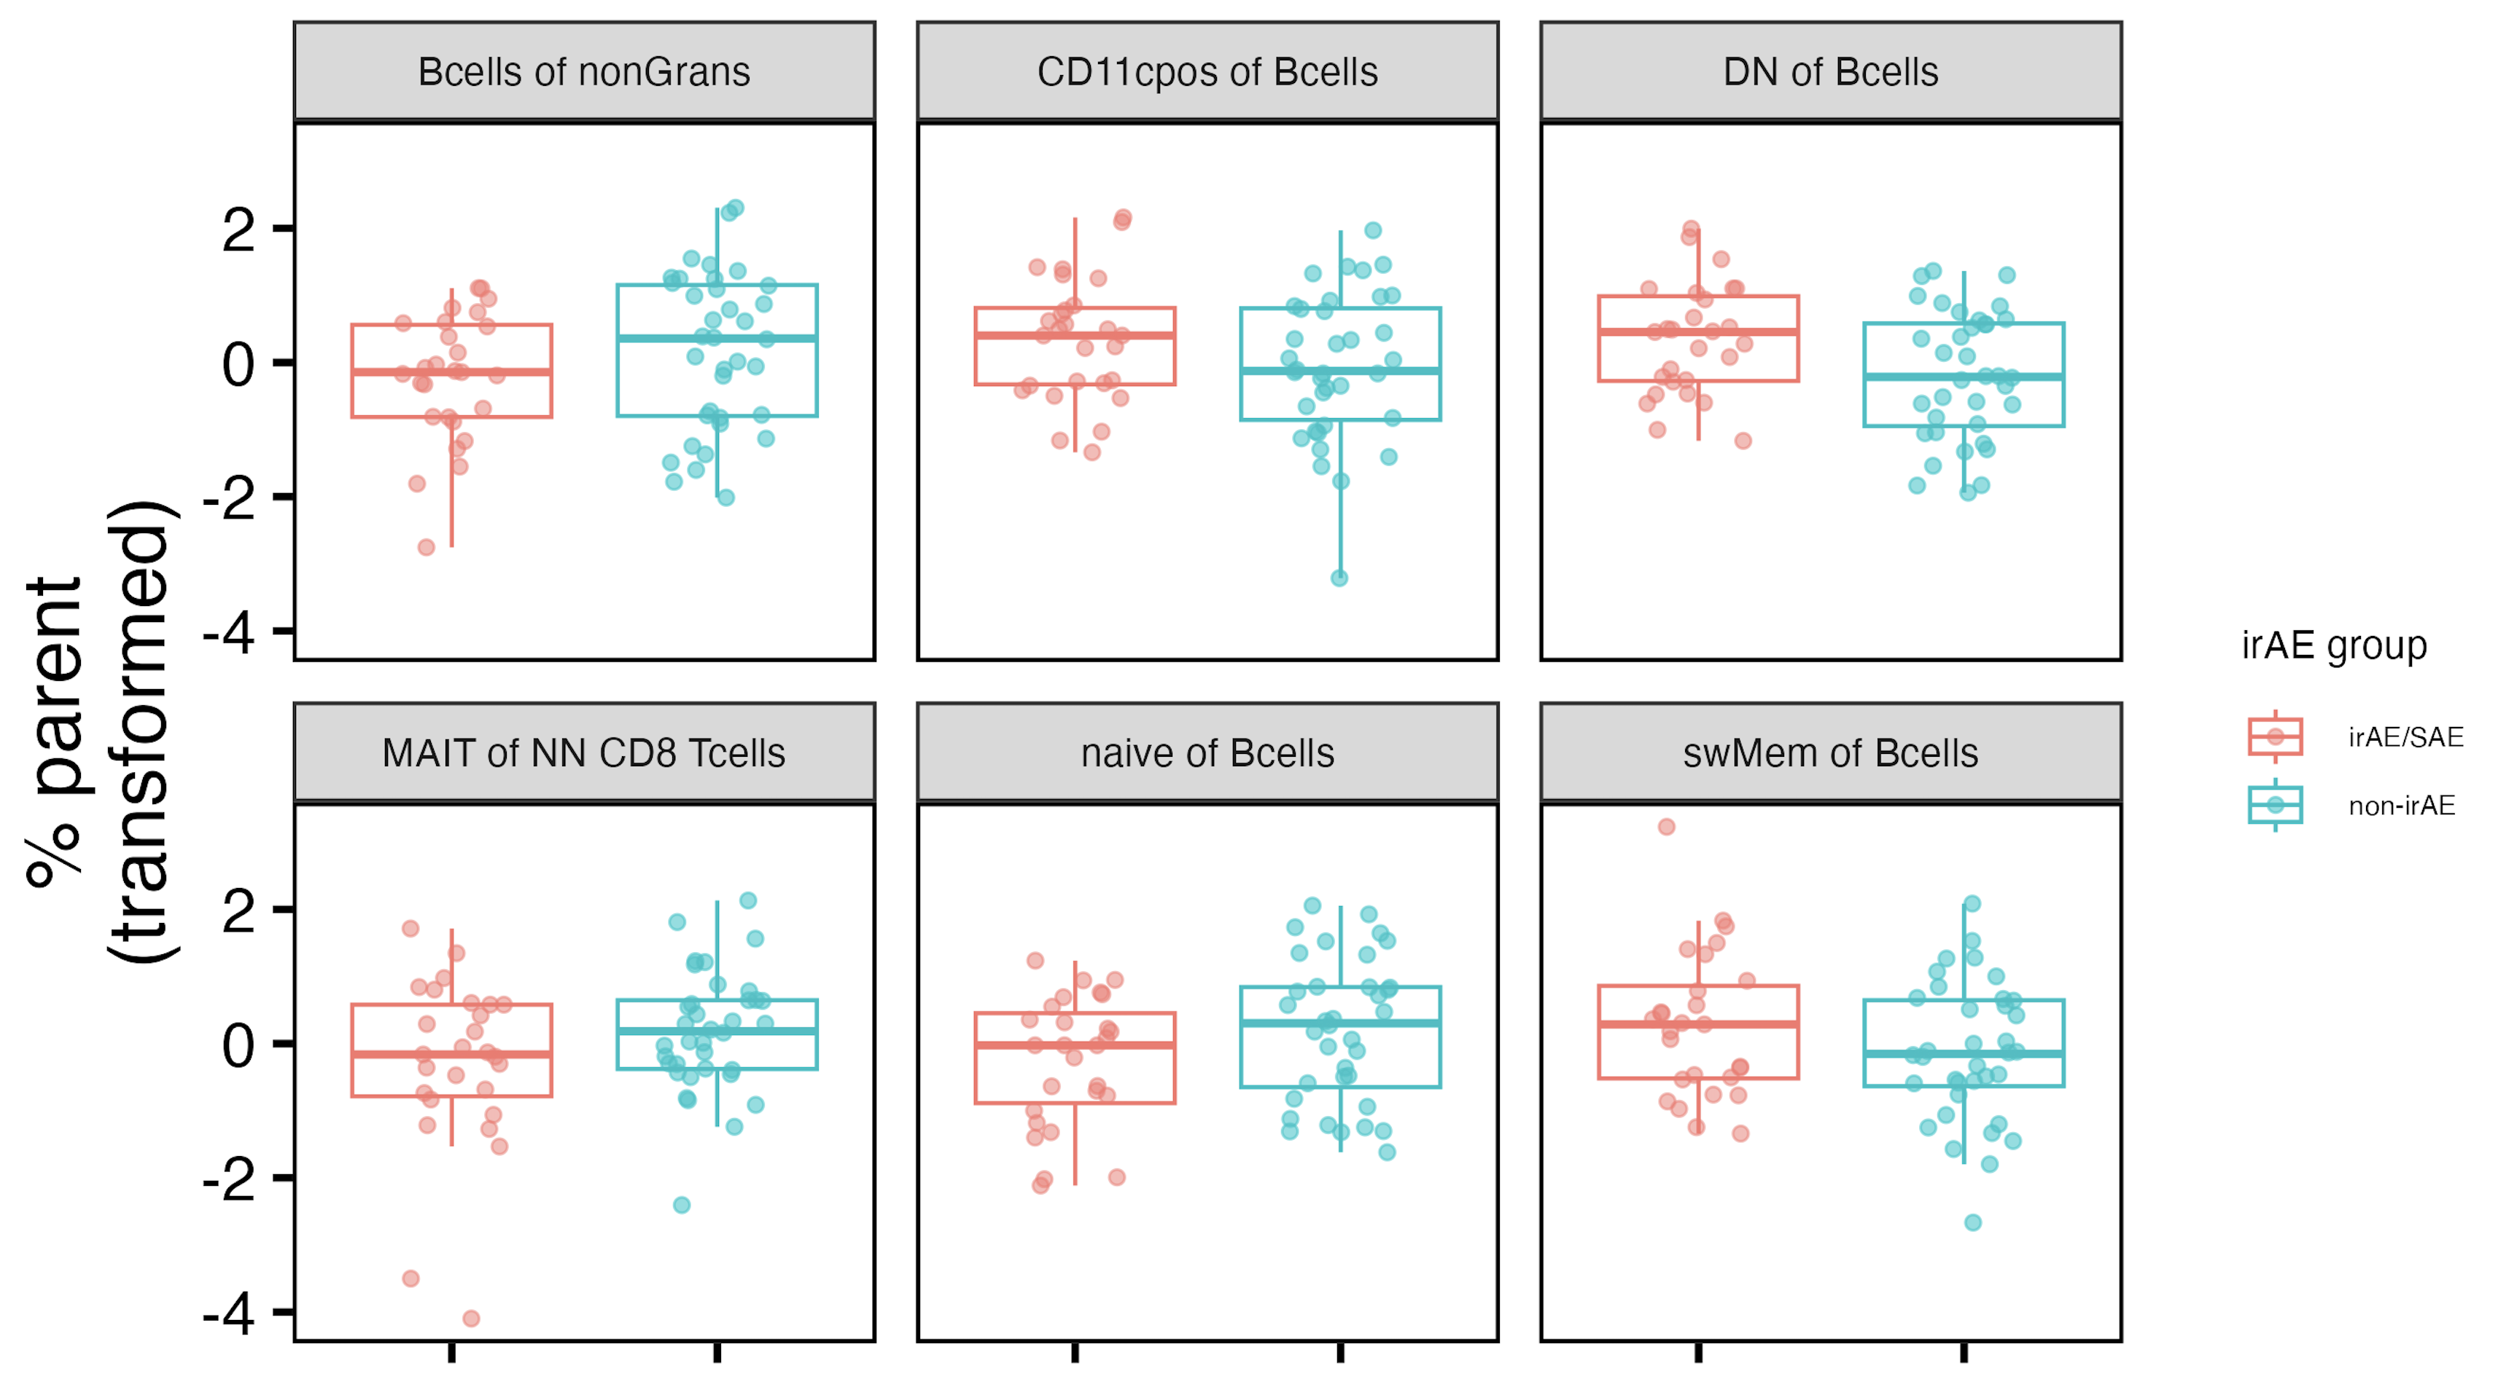
Revisiting borderline baseline combined irAE group differences
Similar for +/- skin irAE
*
~*
~*
~*
~*
~*
padj < 0.05: *
padj < 0.1: ~*
Notes:
Also see Bcells of nonGrans baseline difference for +/- skin irAE (padj < 0.05)

Slide 12
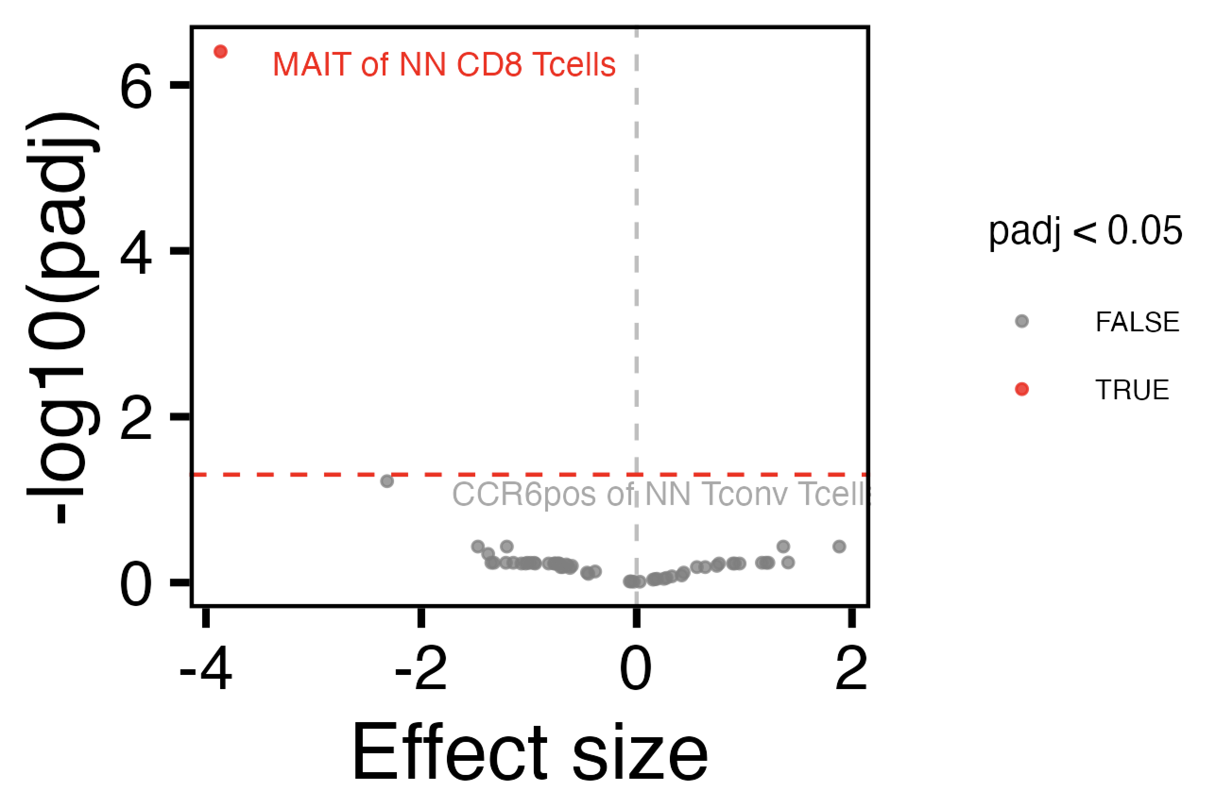
Revisiting borderline baseline thyroid irAE group differences

Slide 13
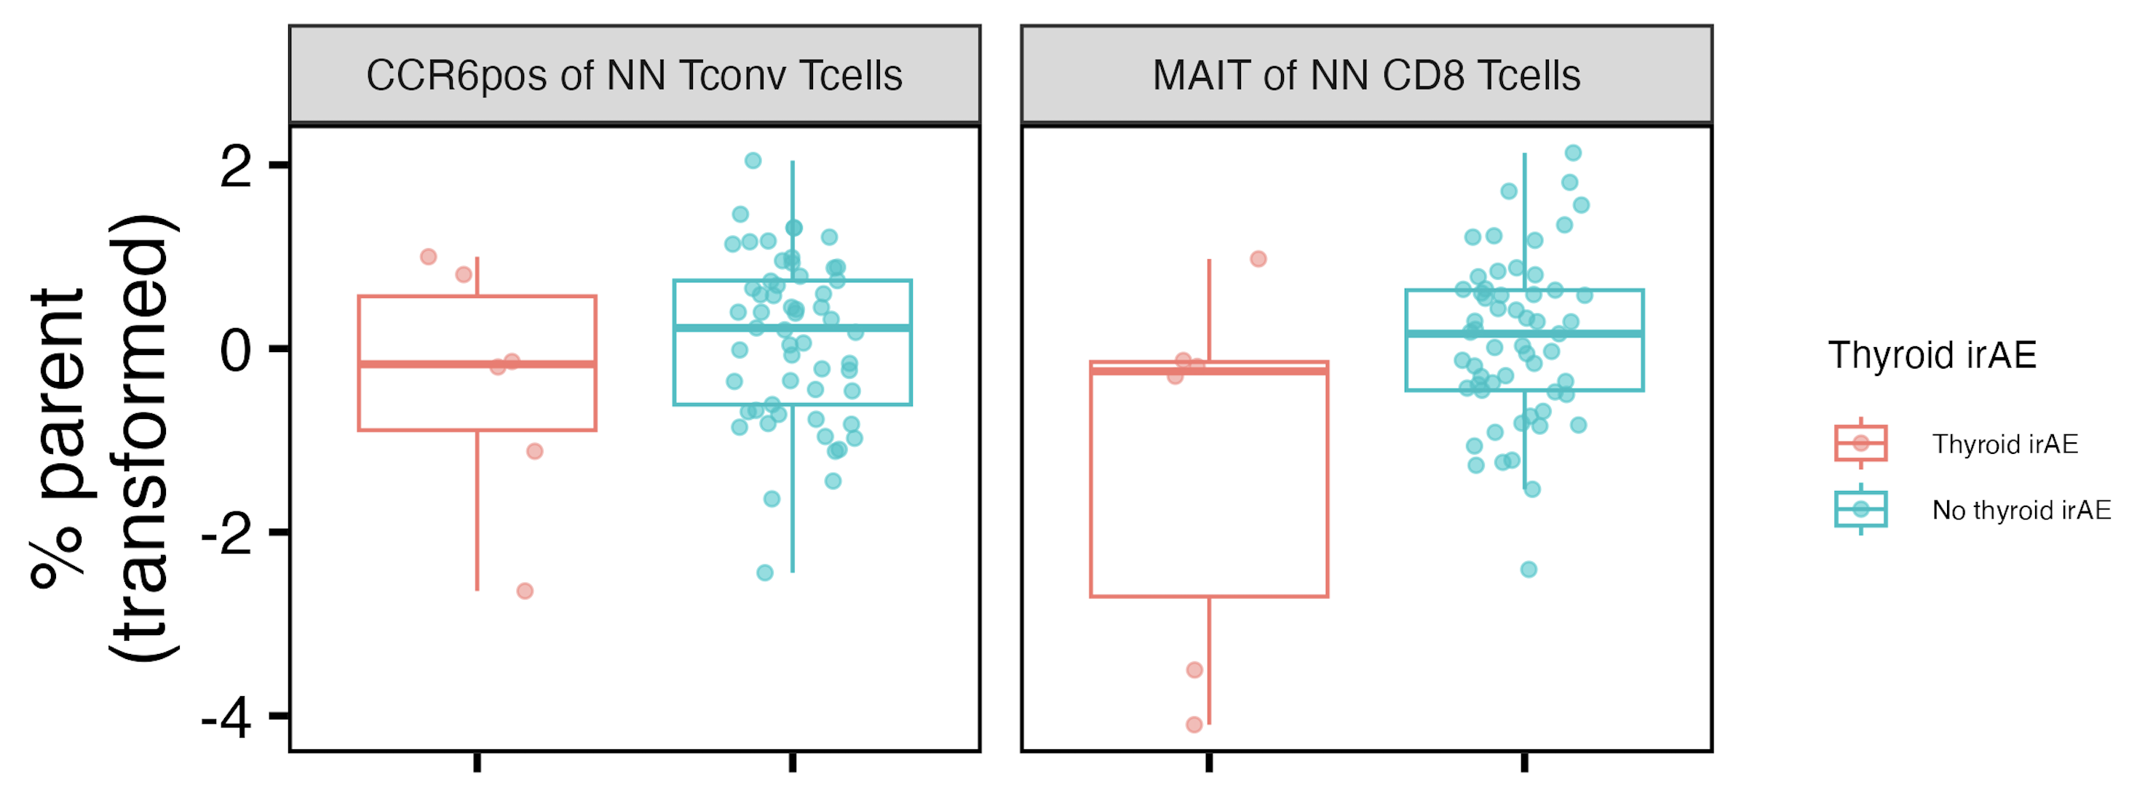
Revisiting borderline baseline thyroid irAE group differences
~*
*
padj < 0.05: *
padj < 0.1: ~*

Slide 14
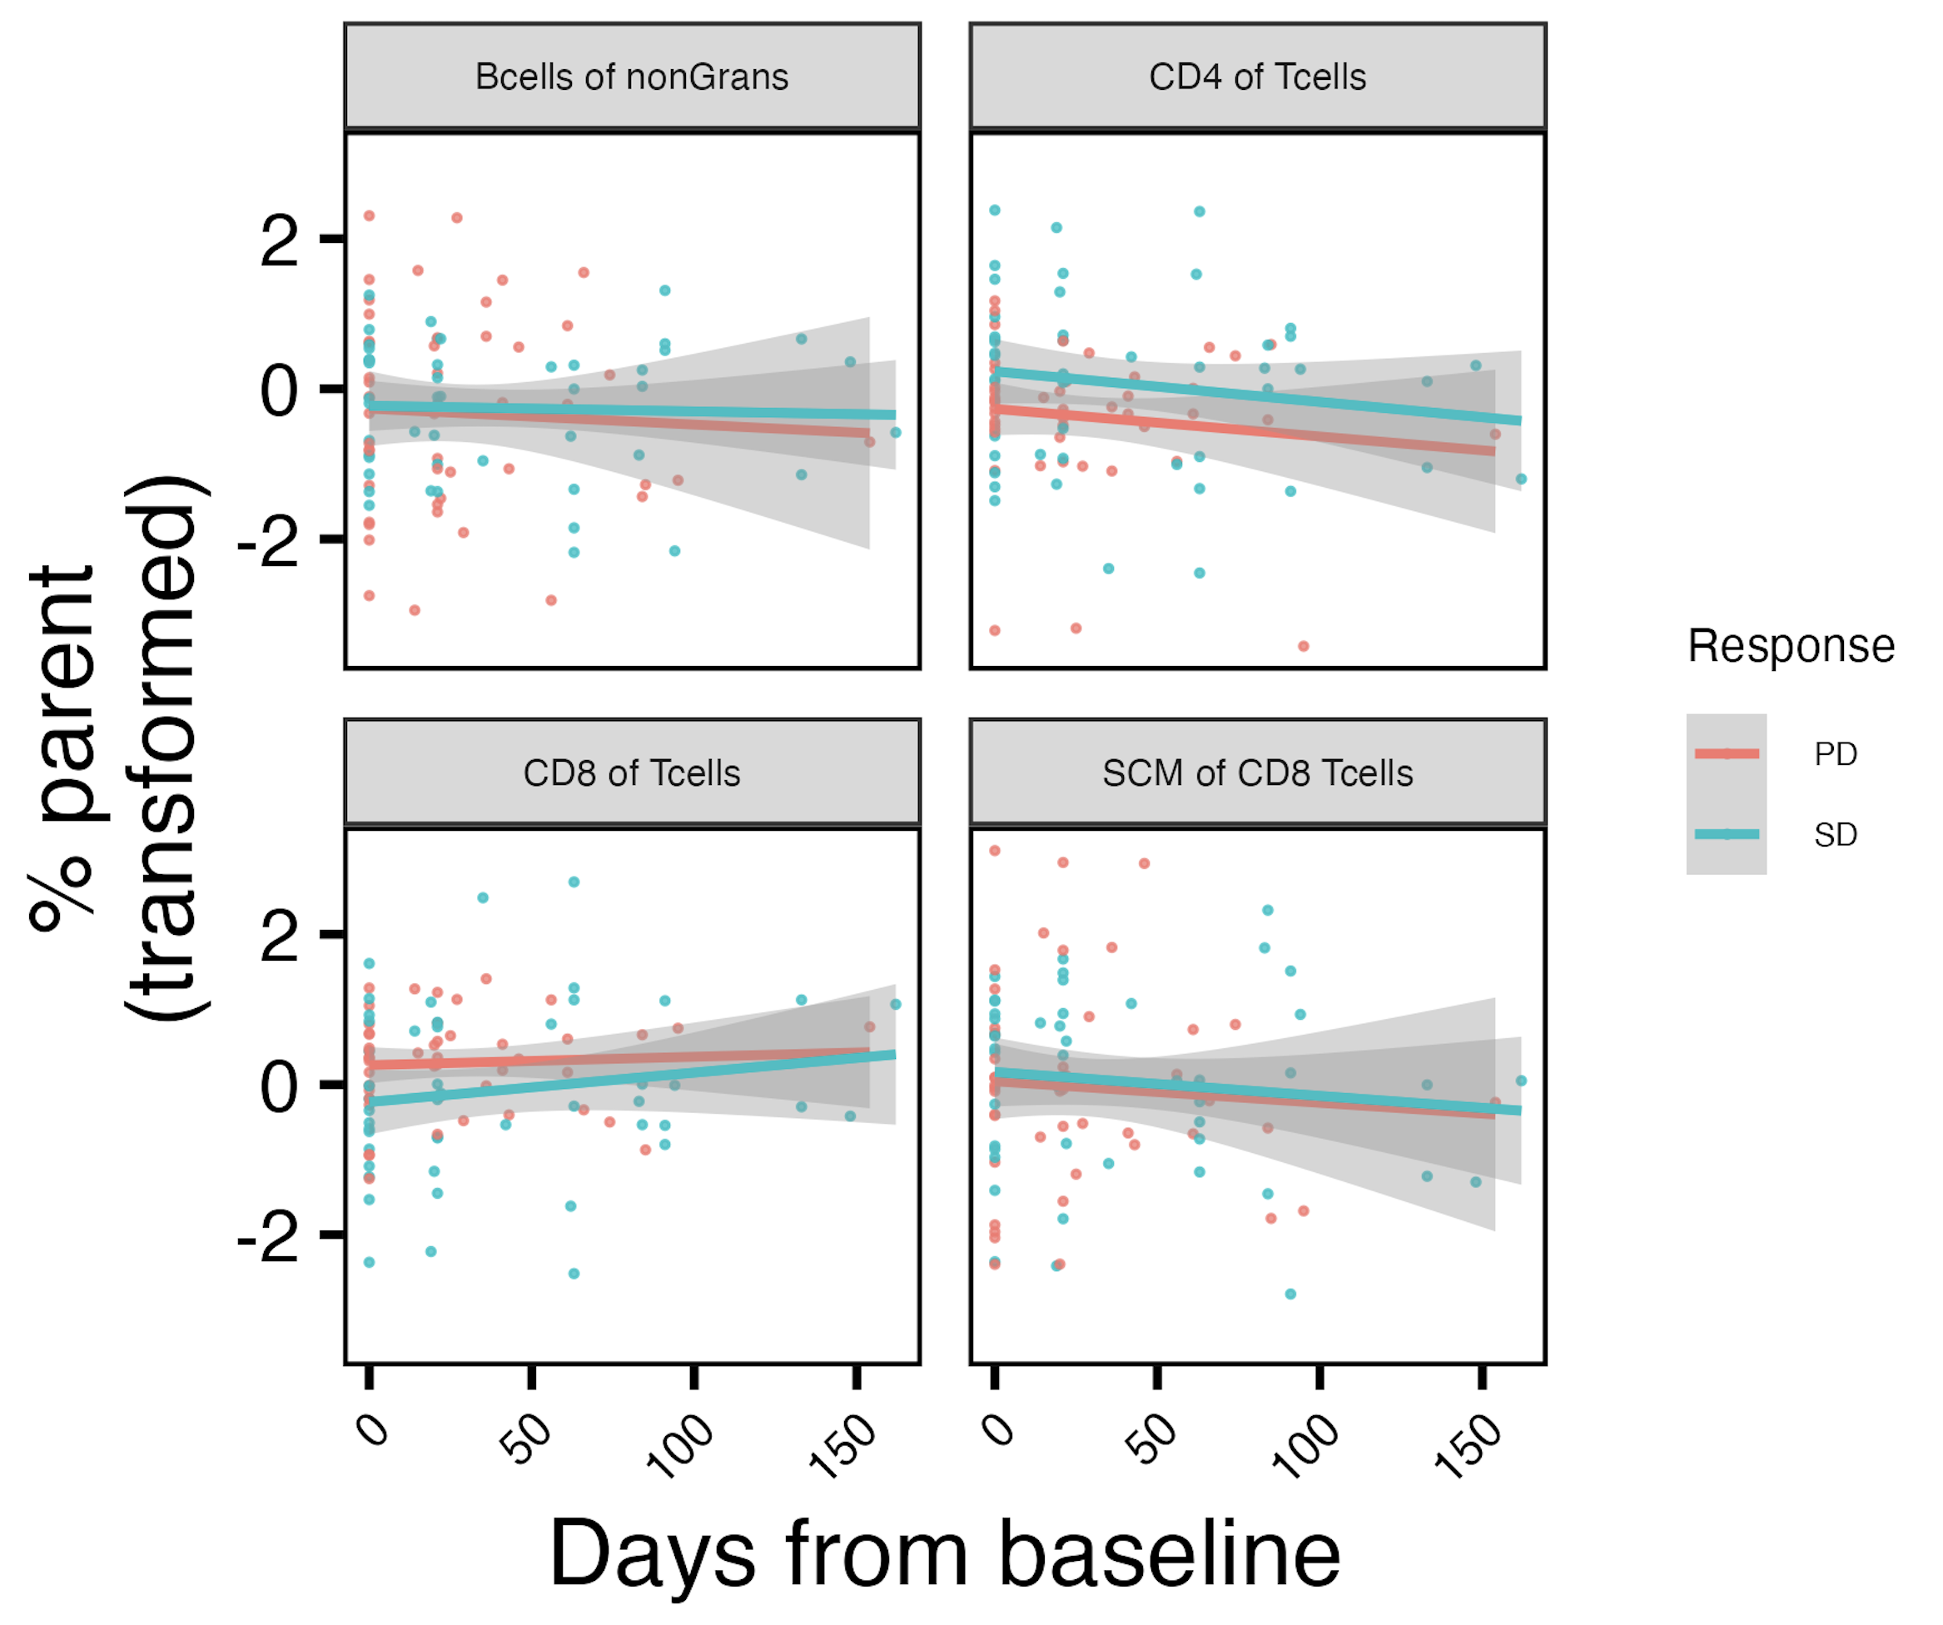
Populations changing differentially over ICI by response group
*
*
*
*
padj < 0.05: *

Slide 15
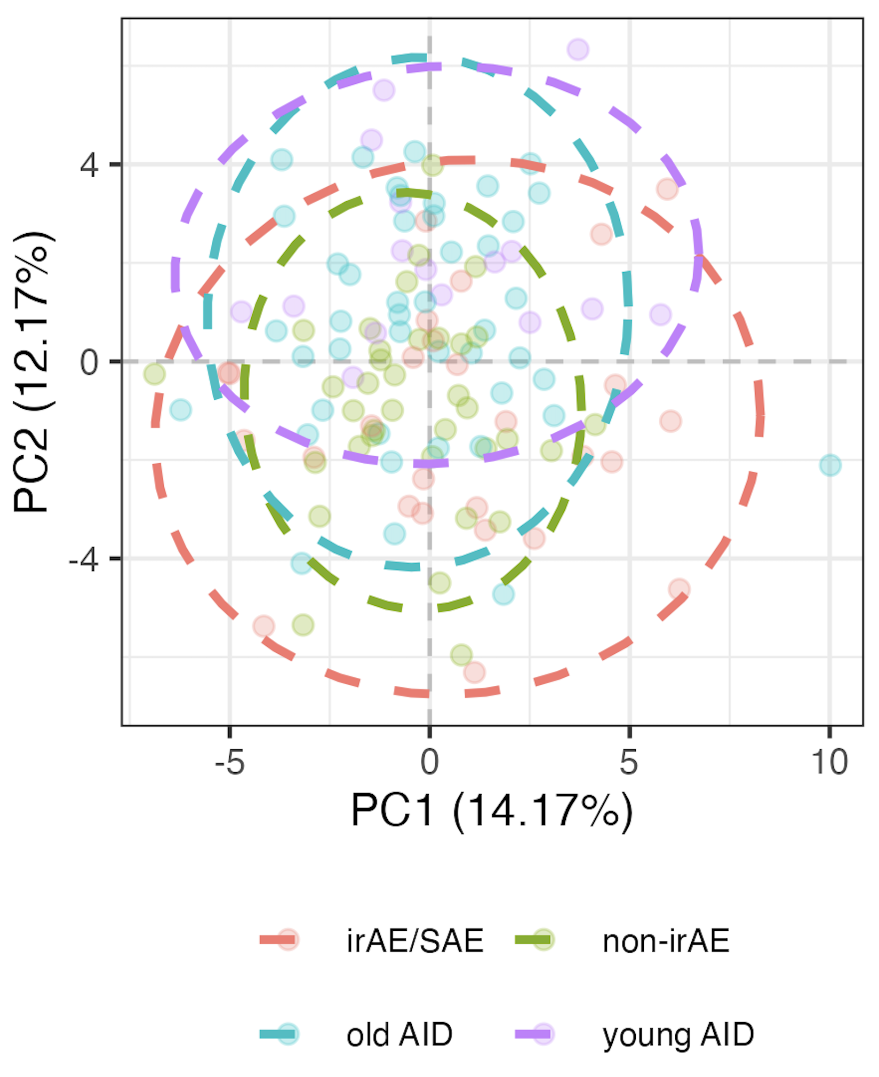
Filtering out young AID patients does not increase support for baseline irAE being more like AID
“Young”: < 44 years old (youngest ICI patient age)
Notes:
Also tried filtering out young AID for projection analyses for longitudinal shifts
Young/”old” split here is 44 yrs (youngest ICI patient)

